Slide 1
IPv6
6CS029 Advanced Networking

Slide 2
Objectives of todays lecture
Brief look at the need for IPV6
Structure of addresses
Scope of Addresses
Autonomous Systems

Slide 3
Confused picture
64% of IPV4 address scope was allocated to North America and only 7% to Asia.
Until several years ago Stanford University had more IPV4 address space than all of China
70% of the largest American Companies use NAT in their Networks
Electronic device manufacturing concentrated in far east – huge interest in IPV6 from these areas as they want to continue selling their products and services

Slide 4
IPv6
Routers etc being produced now are IPV6 compliant
Been slow take up of this mostly because of another technique called Network Address Translation
Until IPv6 completely supplants IPv4, a number of so-called transition mechanisms are needed to enable IPv6-only hosts to reach IPv4 services and to allow isolated IPv6 hosts and networks to reach the IPv6 Internet over the IPv4 infrastructure

Slide 5
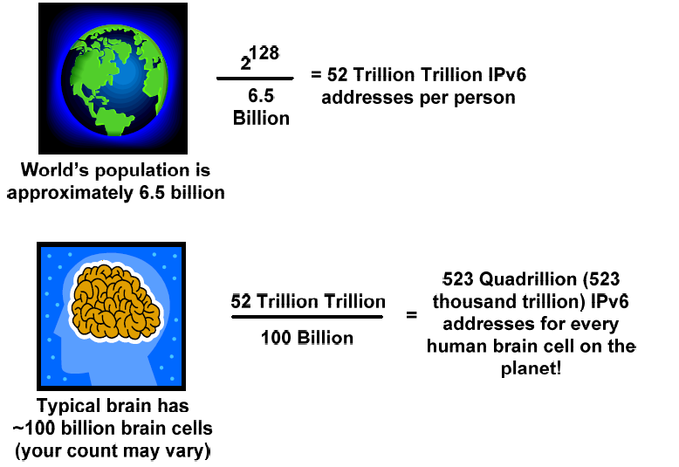
IP addressing scheme based on 128 bits

Slide 6
What is IPV6
IP addressing scheme based on 128 bits
Fixes many of the shortcomings of IPv4
More efficient routing
More efficient packet processing
Directed data flows
Simplified network configuration
No more NAT
Security built in

Slide 7
How will this change affect me
Initially it won’t have a major impact on your life. Most operating systems actually support IPv6, including Mac OS X 10.2 and Windows XP SP 1.
However, many network equipment do not support it as they may well be legacy equipment, making a connection between a device with an IPv6 address to a router or server that only supports IPv4 impossible.
If the switch to IPv6 is not made by the industry, it could also mean things like:
Your favourite web programmes will slow down.
Computers will have a harder time communicating with each other, making the ability to offer services like Skype difficult.

Slide 8
What does an IPV6 address look like
Eight groups of four hexadecimal digits separated by colons:
2604:b200:85a3:0000:0000:8a2e:0370:7334
The hexadecimal digits are case-insensitive.
An IPv6 address can be abbreviated with the following rules:
Omit leading zeroes in a 16-bit value.
Replace one group of consecutive zeroes by a double colon.

Slide 9
Address example
FEDC:BA98:7654:3210:0000:0000:0000:0089
The : breaks the 32 digit hexadec number into chunks of 4 digits
The convention allows for the leading digits of 0 in a chunk of 4 to be omitted
FEDC:BA98:7654:3210:0000:0000:0000:0089
Becomes
FEDC:BA98:7654:3210:0:0:0:89
Also the convention allows that if in one or more of the groups of 4 digits are all zeroes, then they can be omitted
FEDC:BA98:7654:3210::89
here we only have 5 of the 8 groups of hexadec digits and the :: means that they should exist in this location.

Slide 10
Address examples
2604:0000:0000:0000:8A2E:0000:0000:7334
Cannot be expressed as
2604::8A2E::7334
Why?
How would you do it?
2604::8A2E:0:0:7334
What would
fe80 : 0000 : 0000 : 0000 : 0202 : b3ff : fe1e : 8329 be expressed as?

Slide 11
IPV6 address – format basics
2001:acbd:1234:a1b2:0000:0000:0000:0001/64
The first sixty four bits (blue) are network bits, the remaining ones are the host's interface identifier (host bits).
The network portion is going to be given to us either by the ISP or by the registry (ARIN in the US, RIPE in Europe etc.) if we're a big organization.

Slide 12

Aggregatable global unicast addresses - equivalent to an IPV4 address
All AGUs have the first 3 bits set to this
First digit will always be a 2
Next Level AID Used to identify a specific customer site
Top Level Aggregation Identifier given
Out to the worlds largest ISPs.- more efficient routing
Site Level AID Used within the customer site to form subnets

Slide 13
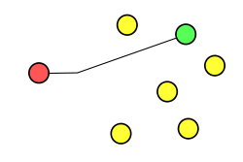
Types of IPV6 addresses
There are 3 major types of IPV6 addresses
Unicast – an address for a single node (PC, server, printer etc.). A packet that is sent to a unicast address is delivered to the interface identified by that address
Notes:
Unicast is an individual address for a particular host
Anycast is used where there may be multiple devices but which replicate the same job. Several of the DNS root servers use a router-based anycast implementation, which is really a shared unicast addressing scheme. (While there are only thirteen authoritative root server names, the total number of actual servers is considerably larger, and they are spread all over the globe.) The same IP address is assigned to multiple interfaces, and then multiple routing tables entries are needed to move everything along.
Multicast – a packet sent to a group of nodes that need to receive it. E.g. you may want to send a video to a group of PCs those the users can watch it. Not every PC needs to view it so it routed to those with the one multicast address.

Slide 14
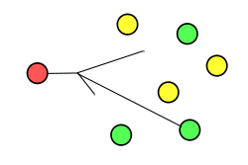
e
Anycast – an address for a set of interfaces that typically belong to different nodes. Anycast addressing routes datagrams to a single member of a group of potential receivers that are all identified by the same destination address. This is a one-to-one-of-many association.

Slide 15
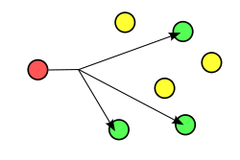
Multicast—An address for a set of interfaces in a given scope that typically belong to different nodes. A packet sent to a multicast address is delivered to all interfaces identified by the multicast address in a given scop

Slide 16
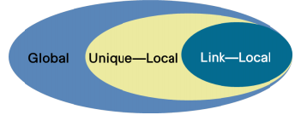
Address scope
Every IPv6 address has a "scope", which specifies in which part of the network it is valid.
Another aspect of IPv6 addressing is the concept of address scopes.
Figure 1 represents the scopes that an IPv6 address can have.

Slide 17
A link-local address -
is used for communications on a single link
packets that have a link-local source or destination address are not forwarded by a router off that link.
only have meaning on that link.
can be identified as starting with the FE80::/10 prefix.
an identical address might exist on another link, so the address is not routable off its link.
router
Switch
Switch

Slide 18
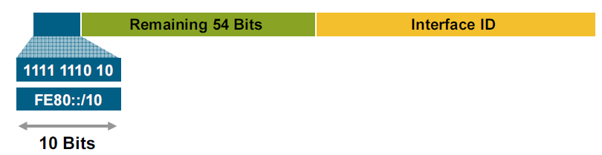
Link-local
Can be left as 0
All IPv6 interfaces have a link-local address assigned to them.
Locally generated as there may not be a DHCP server so it’s mandatory to have one so communications can happen on that link

Slide 19
64 bit Interface ID
This can come from
A DHCP server
Be derived from the 48 bit MAC address which is unique using EUI-64
Come from a randomly generated number
Manually configured

Slide 20
Unique Local addresses
Equivalent to the NAT addresses used in IPV4
IPv6 Unique Local addresses are routable inside of a company's multiple sites.
FC00::/7 or FD00::/7
Used for
Local communications
Inter-site VPNs
Not routable on the Internet
router
Switch
Switch

Slide 21
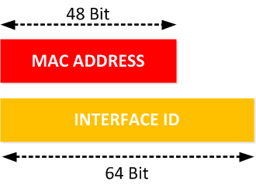
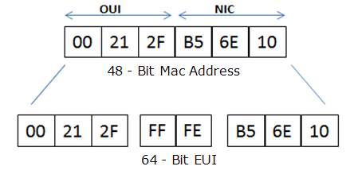
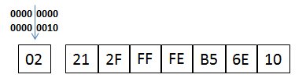
EUI-64
MAC address split in two and FFFE inserted to make it 64 bit
The 7th most Significant bit is then flipped ( 0 becomes 1 and visa versa)
Notes:
MAC Address Filtering: Networks can use MAC address filtering, only allowing devices with specific MAC addresses to connect to a network. This isn’t a great security tool because people can spoof their MAC addresses.
MAC Authentication: Some Internet service providers may require authentication with a MAC address and only allow a device with that MAC address to connect to the Internet. You may need to change your router or computer’s MAC address to connect.
Device Identification: Many airport Wi-Fi networks and other public Wi-Fi networks use a device’s MAC address to identify it. For example, an airport Wi-Fi network might offer a free 30 minutes and then ban your MAC address from receiving more Wi-Fi. Change your MAC address and you could get more Wi-Fi. (Free, limited Wi-Fi may also be tracked using browser cookies or an account system.)
Device Tracking: Because they’re unique, MAC addresses can be used to track you. When you walk around, your smartphone scans for nearby Wi-Fi networks and broadcasts its MAC address. A company named Renew London used trash bins in the city of London to track people’s movements around the city based on their MAC addresses. Apple’s iOS 8 will use a random MAC address each time it scans for nearby Wi-Fi networks to prevent this sort of tracking.
when the NIC card is made In it’s MAC address the 7th bit is always set to 0
It is possible to change the MAC address in software (locally administered) In this case the 7th most significant bit is set 1.
In EUI-64 this seventh bit is flipped when creating the IPV6 address
Windows, Linux, Mac allow you to set a MAC address. (in windows its via the properties for the network card)

Slide 22
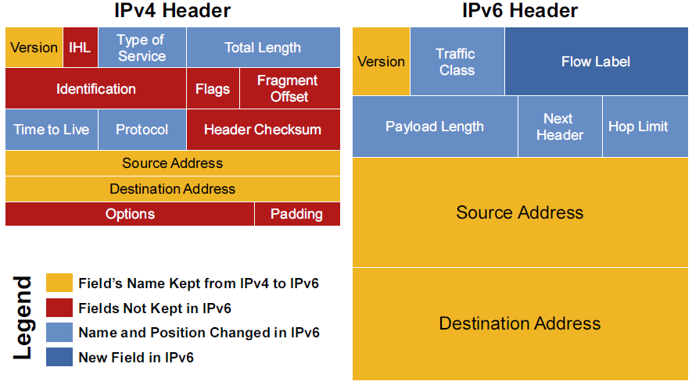
Comparison of Packet header
14 fields to look at and maybe compute
Only 8 in IPV6

Slide 23


IPV6 header
In IPV4 the length of the header between 20 to 60 Bytes – IPV6 fixed at 40 bytes
6 2
Type of Service to let the Router know what services should be provided to this packet.
used for Explicit Congestion Notification (ECN)
is used to maintain the sequential flow of the packets belonging to a communication.
source labels the sequence to help the router identify that a particular packet belongs to a specific flow of information.
This field helps avoid re-ordering of data packets. It is designed for streaming/real-time media.
20 bits
Notes:
Without ECN, switches respond to network congestion by dropping TCP/IP packets. Dropped packets signal the network that congestion is occurring. Devices on the IP network respond to TCP packet drops by reducing the packet transmission rate in order to allow the congestion to clear. However, the packet drop method of congestion notification and management has some disadvantages. For example, packets are dropped and must be retransmitted. And bursty traffic can cause the network to reduce the transmission rate too much, resulting in inefficient bandwidth utilization.
Instead of dropping packets to signal network congestion, ECN marks packets to signal network congestion, without dropping the packets. For ECN to work, all of the switches in the path between two ECN-enabled end
A flow is a sequence of packets that are sent from a particular source to a particular, unicast or multicast, destination. The source also requires special handling by the intervening routers. The nature of the special handling might be conveyed to the routers by a control protocol. The control protocol can be a resource reservation protocol. The special handling also might be conveyed by information within the flow's packets, for example, in a hop-by-hop option.
Active flows from a source to a destination can be multiple. Active flows can also contain traffic that is not associated with any flow. The combination of a source address and a nonzero flow label uniquely identifies a flow. Packets that do not belong to a flow carry a flow label of zero.
The flow's source node assigns a flow label to a flow. New flow labels must be chosen randomly, in a “pseudo” manner. New flow labels must also be chosen uniformly from the range 1 to FFFFF hex. This random allocation makes any set of bits within the flow label field suitable for use as a hash key by routers. The routers can use the hash key to look up the state that is associated with the flow.
points must have ECN enabled. ECN is negotiated during the establishment of the TCP connection between the endpoints.

Slide 24



IPV6 Header
used to tell the routers how much information a particular packet contains in its payload.
Payload is composed of Extension Headers and Upper Layer data.
With 16 bits, up to 65535 bytes can be indicated
16 bits
same as TTL in IPv4. The value of Hop Limit field is decremented by 1 as it passes a link (router/hop).
When the field reaches 0 the packet is discarded.
8-bits
In IPv6, the Fixed Header contains only that much information which is necessary, avoiding that information which is either not required or is rarely used
Further headers can be used if needed for that information
8-bits

Slide 25
Neighbour Discovery Protocol
This allows different nodes on the same link to advertise their existence to their neighbours, and to learn about the existence of their neighbors.
Routers and hosts (nodes) use Neighbour Discovery (ND) messages to determine the link-layer addresses of neighbors that reside on attached links and to overwrite invalid cache entries. Hosts also use ND to find neighbouring routers that can forward packets on their behalf.
In addition, nodes use ND to actively track the ability to reach neighbours. When a router (or the path to a router) fails, nodes actively search for alternatives to reach the destination.

Slide 26
IPV6 Tunnelling
Legacy IPV4 equipment is still in use in networks and IPV6 packets must be able to traverse it

Slide 27
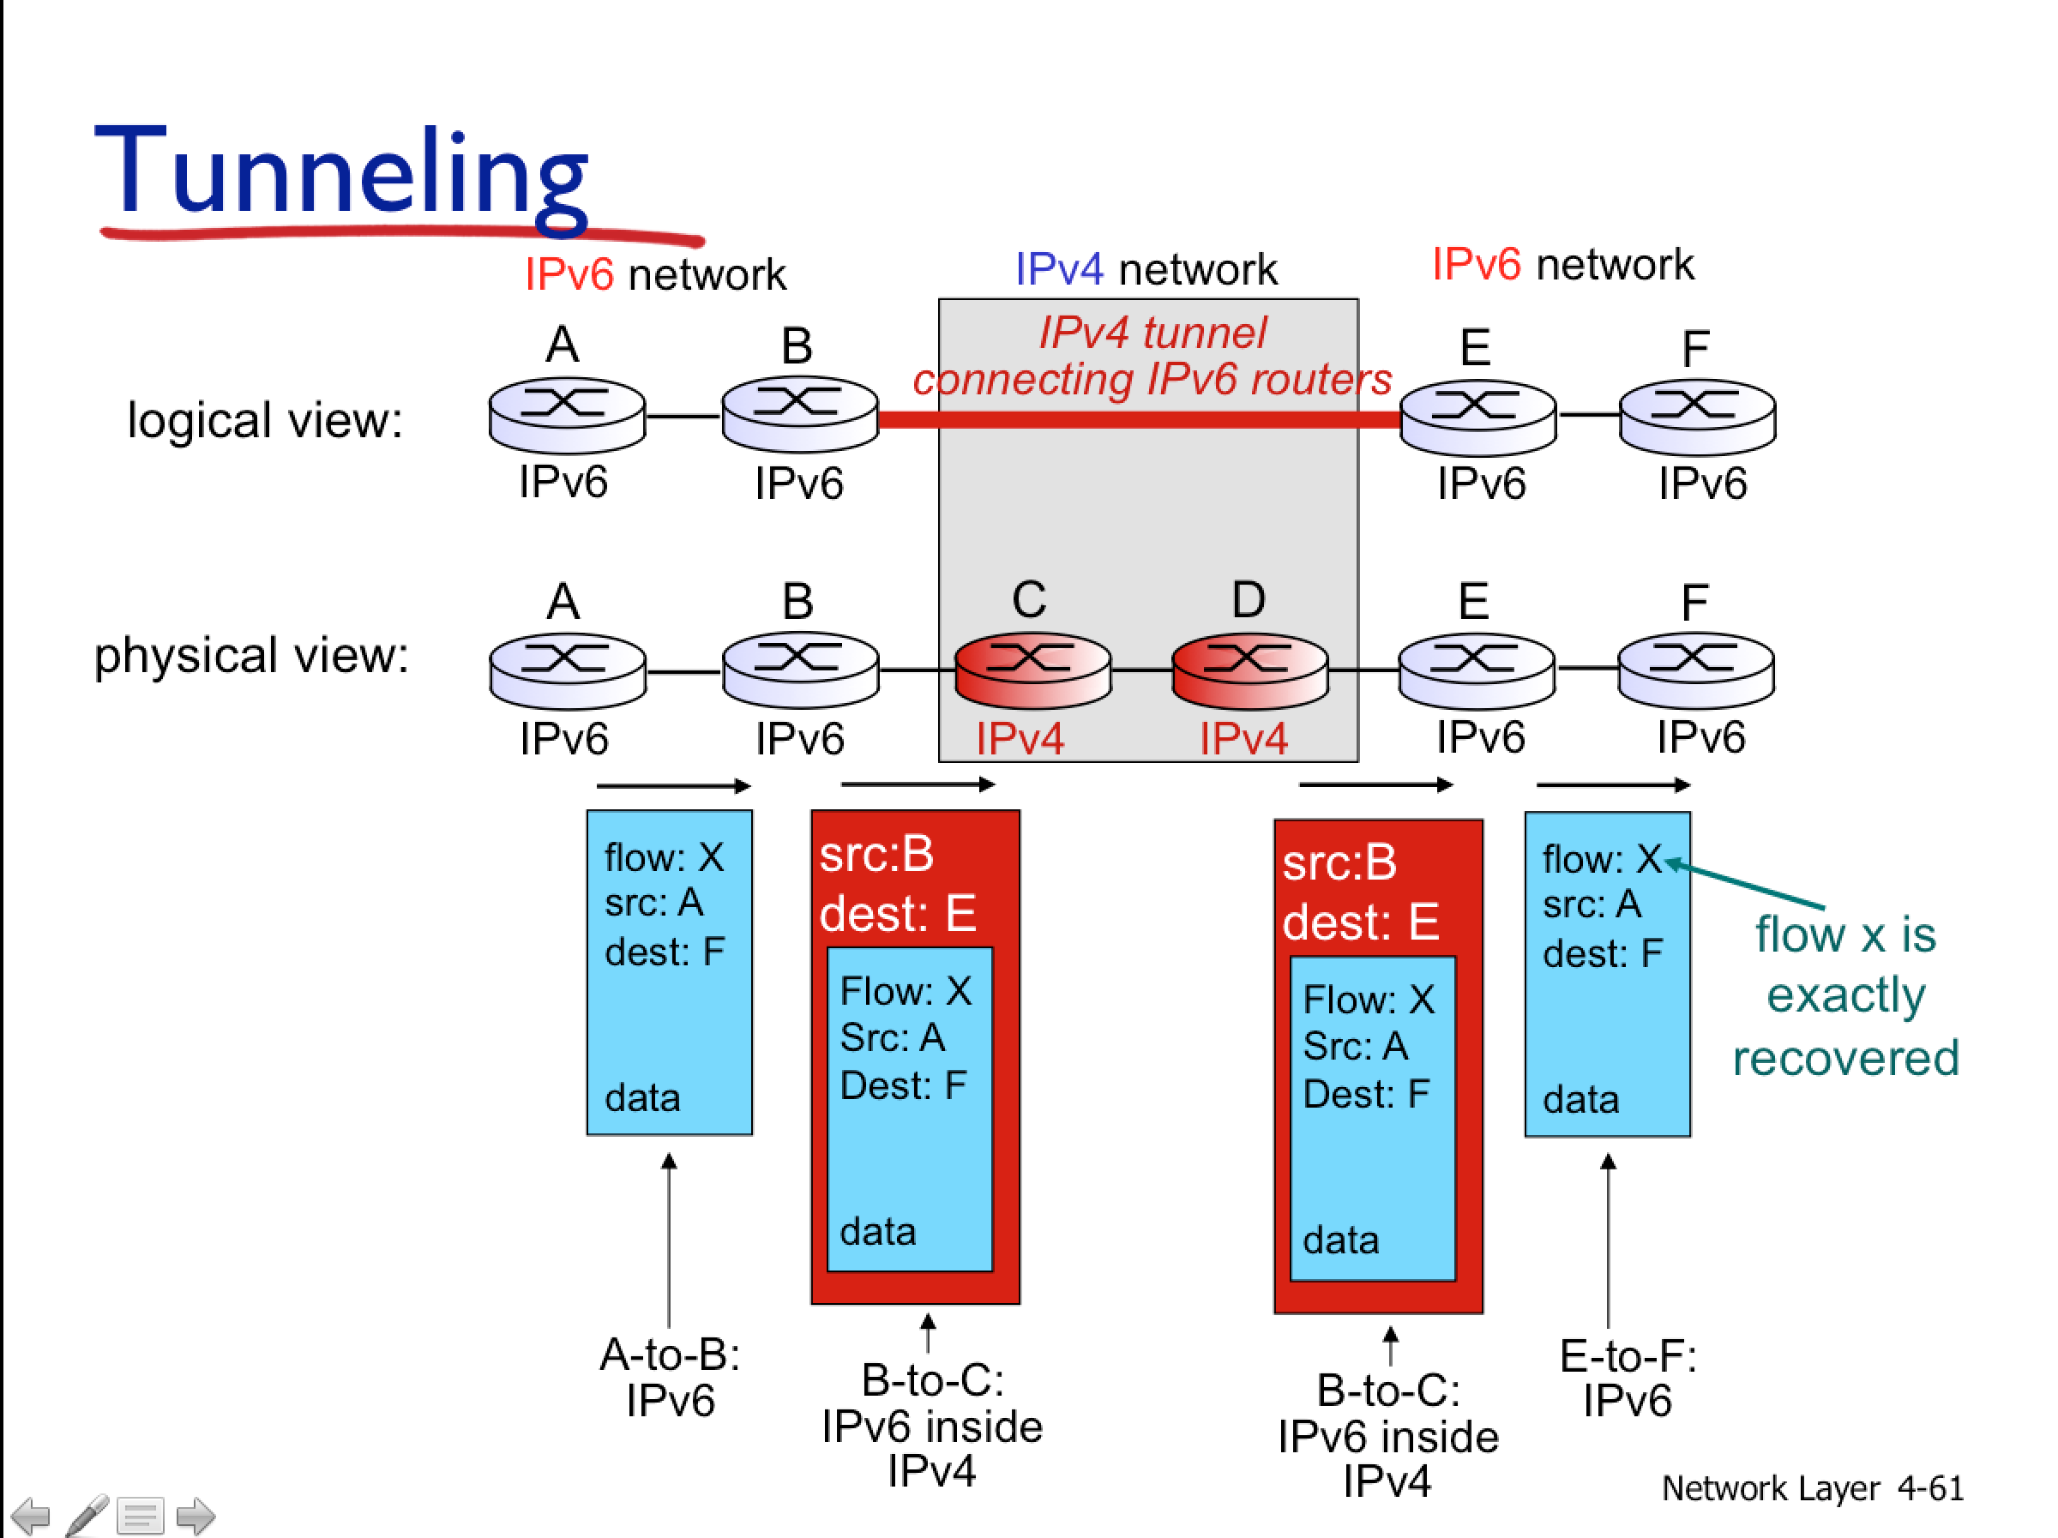

Slide 28
IPV6 interior routing protocols
Interior routing protocols
RIPng (new generation)
OSPFv3 – version 3 of the link state routing protocol
EIGRP for IPV6 – routing protocol with more sophisticated metric
IS-ISv6 – another link state protocol which is fast becoming widely used (similar to OSPF)

Slide 29
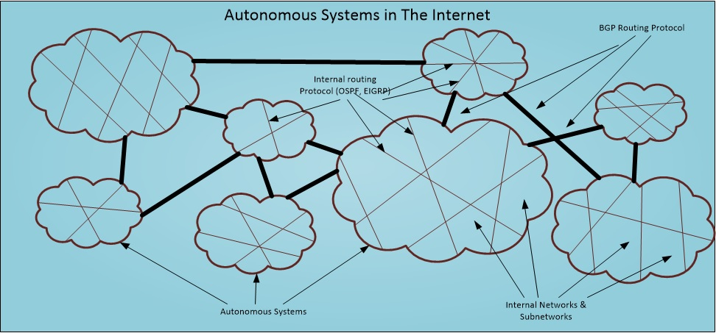
Exterior Routing Protocol
Used to route packets between Autonomous Systems
Each one is given a number, and there are at least 90,000 of these ASs in the world.
The AS number for the BBC is 2818

Slide 30
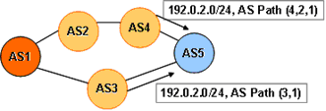
Exterior Routing Protocol - BGP
Border Gateway Protocol is used almost exclusively as the exterior routing protocol between ASs.
AS1 will advertise that 192.0.2.0 /24 networks reside within it to both AS2 and 3. As it passes through these ASs will add their domain number to the advert and also store it in their edge routers.
As the advert propagates through the ASs a path to 192.0.2.0 is constructed
192.0.2.0 has 2 possible paths.
BGP metric is called Multi Exit Discriminator (MED)
makes routing decisions based on paths, network policies, or rule-sets configured by a network administrator
192.0.2.0 /24
Notes:
The inter-domain routing space is constructed using two components: address prefixes and AS numbers , which are used as domain identifiers. Every prefix has an originating domain, known as the “origin AS” from which reachability for the prefix is propagated across the inter-domain space.
As the routing advertisement is propagated across the inter-domain space each prefix accumulates an associated “AS Path”. As a prefix advertisement transits each domain, the domain effectively “signs” the prefix advertisement by having its AS number prepended to the AS Path associated with the address prefix. At any point in the network the AS path describes a sequence of connected domains which forms a path from the current point to the originating domain. This is shown in Figure 1, where AS 1 originates an advertisement for the address prefix 192.0.2.0/24. At AS 5, the AS will receive two BGP advertisements for this prefix. One will have the AS Path (4,2,1), while the other will have the AS Path (3,1). The AS Path is a sequence of AS number values. The left-most number is the AS number of the adjacent Autonomous System from which the address prefix advertisement was received. The sequence of numbers indicates the sequence of Autonomous Systems though which this update was propagated. The right-most, or final AS number is the AS number of the Autonomous System that originated the address prefix advertisement, or “OriginAS”.
BGP Path Selection Criteria
BGP tries to narrow its path selection down to one best path; it does not load balance by default. To do so, it examines the path attributes of any loop-free, synchronized (if synchronization is enabled) routes with a reachable next-hop in the following order:
Choose the route with the highest weight.
If weight is not set, choose the route with the highest local preference.
Choose routes that this router originated.
Choose the path with the shortest Autonomous System path.
Choose the path with the lowest origin code (i is lowest, e is next, ? is last).
Choose the route with the lowest MED, if the same Autonomous System advertises the possible routes.
Choose an EBGP route over an IBGP route.
Choose the route through the nearest IGP neighbor as determined by the lowest IGP metric.
Choose the oldest route
Choose a path through the neighbor with the lowest router ID.
Choose a path through the neighbor with the lowest IP address.

Slide 31
How do ASs interconnect?
ASes connect with each other and exchange network traffic (data packets) through peering.
One way ASes peer with each other is by connecting at physical locations called Internet Exchange Points(IXPs).
This reduces costs, latency etc. as it does not require the data being passed up to a tier 1 provider and then having to come down to the other AS.
Map of IPXs https://www.internetexchangemap.com/

Slide 32
IPV6 advantages and disadvantages
Advantages
Disadvantages
Bigger address space
No need to use DHCP
No need for broadcasts
More efficient headers
Address space is so large makes IP scanning unfeasible – more secure makes automated worm spreading more difficult
Virtually limitless address space on each prefix
Address space is so large makes port scanning unfeasible – makes security and accounting checking unfeasible
Impossible to remember and type long addresses

